Slide 1
Project title: Emotion Recognition From Speech and Beyond Domain: Audio Supervisor: Dr. Sriram Ganapathy Mentor: Karthick Raja Team: 7 Team members: Ranjit Patil Paritosh Mangrulkar Vijayalakshmi Padmanaban Balaji Raghavan Tamilselvan Sivanantham Date: February-2023

Slide 2
Contents
Dataset
Data Exploration and Visualization
Pre-processing steps
Exploration of various Models and their Performances Metrics
DOE for Final Model for Hyper-parameter Tuning
Tuned Model Performance Metrics
Conclusions

Slide 3
Dataset
Ravdess Dataset
The Ryerson Audio-Visual Database of Emotional Speech and Song RAVDESS contains 1440 files: 60 trials per actor x 24 actors = 1440. The RAVDESS contains 24 professional actors (12 female, 12 male), vocalizing two lexically-matched statements in a neutral North American accent. Speech includes calm, happy, sad, angry, fearful, surprise, and disgust expressions. Each expression is produced at two levels of emotional intensity (normal, strong), with an additional neutral expression. The conditions of the audio files are: 16bit, 48kHz .wav.
File naming convention
Each of the 1440 files has a unique filename. The filename consists of a 7-part numerical identifier (e.g., 03-01-06-01-02-01-12.wav). These identifiers define the stimulus characteristics:
Filename identifiers
Modality (01 = full-AV, 02 = video-only, 03 = audio-only).
Vocal channel (01 = speech, 02 = song).
Emotion (01 = neutral, 02 = calm, 03 = happy, 04 = sad, 05 = angry, 06 = fearful, 07 = disgust, 08 = surprised).
Emotional intensity (01 = normal, 02 = strong). NOTE: There is no strong intensity for the 'neutral' emotion.
Statement (01 = "Kids are talking by the door", 02 = "Dogs are sitting by the door").
Repetition (01 = 1st repetition, 02 = 2nd repetition).
Actor (01 to 24. Odd numbered actors are male, even numbered actors are female).

Slide 4
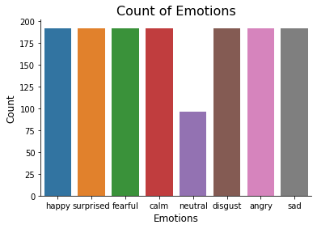
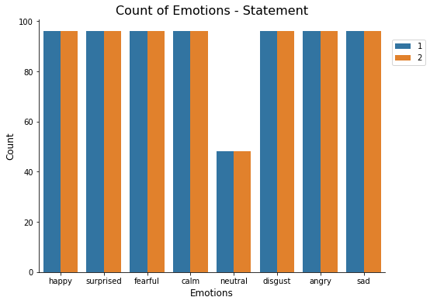
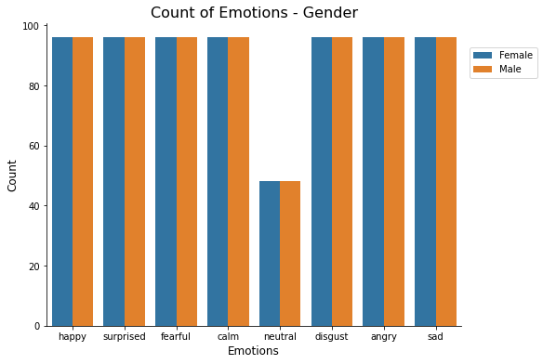
Data Exploration and Visualizations
This dataset is well balanced except for Neutral category. Stratified k fold is used to get same proportion.

Slide 5
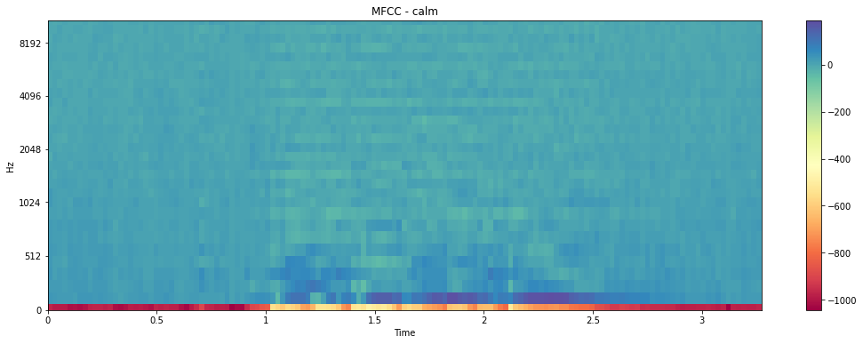
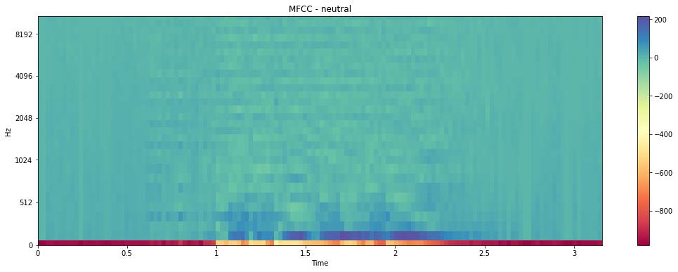
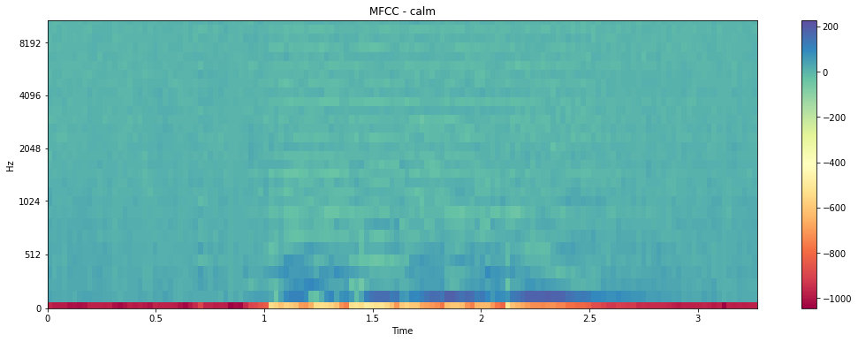
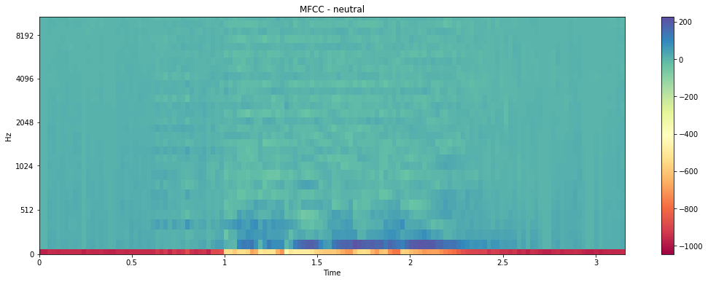
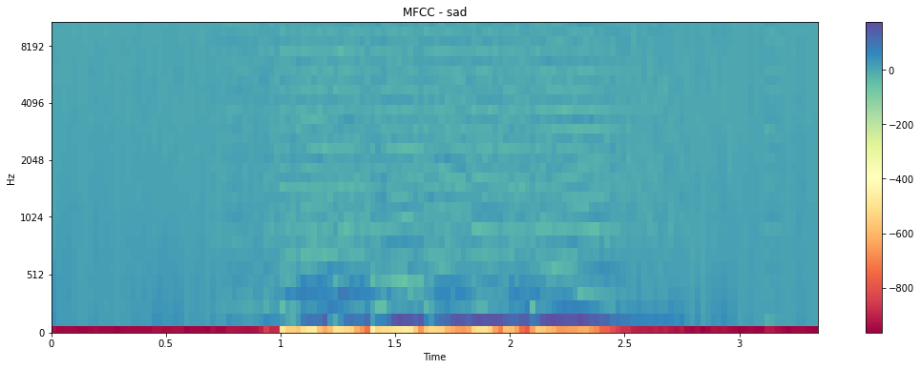
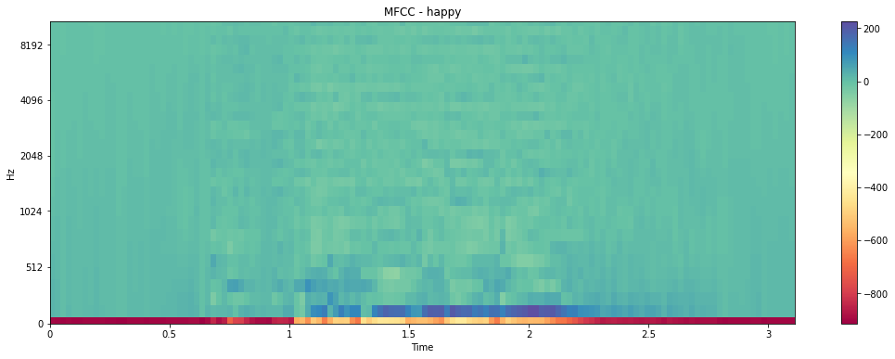
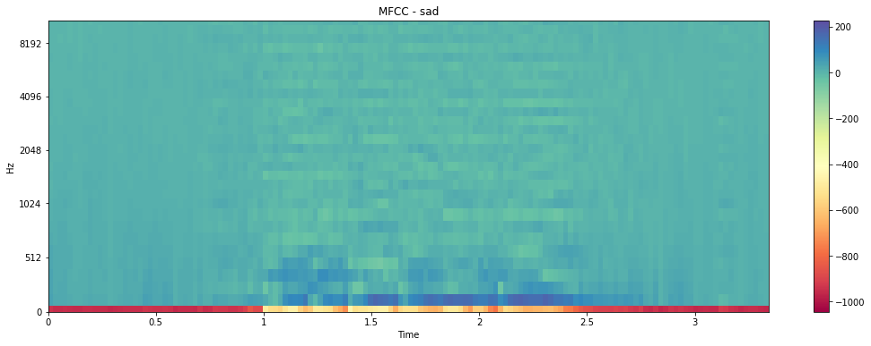
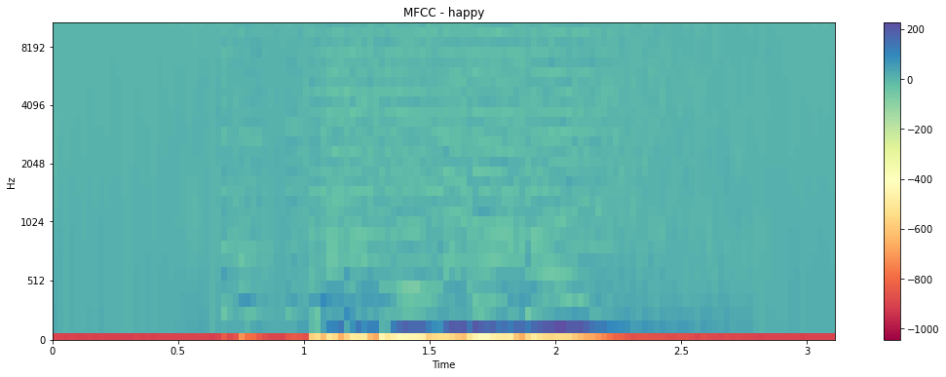
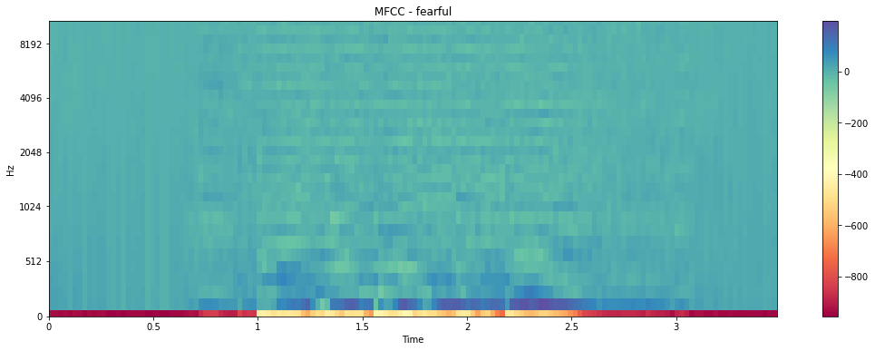
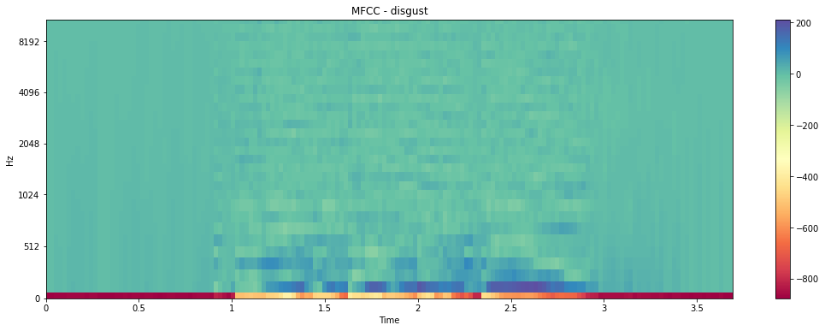
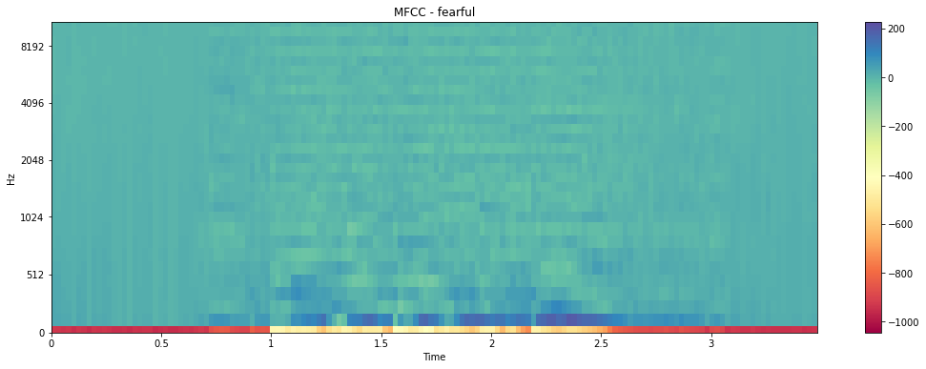
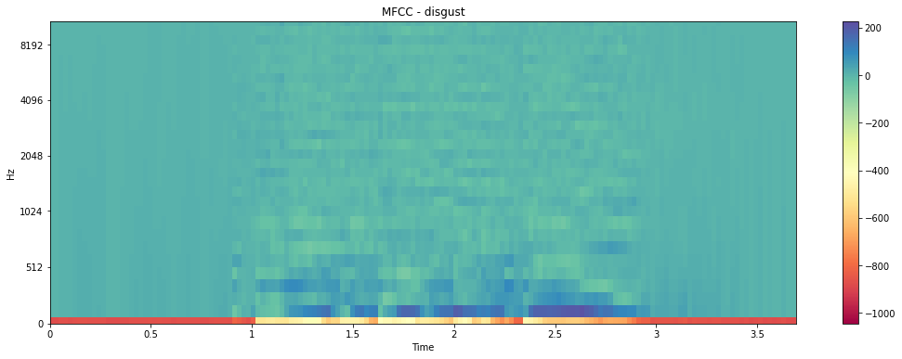
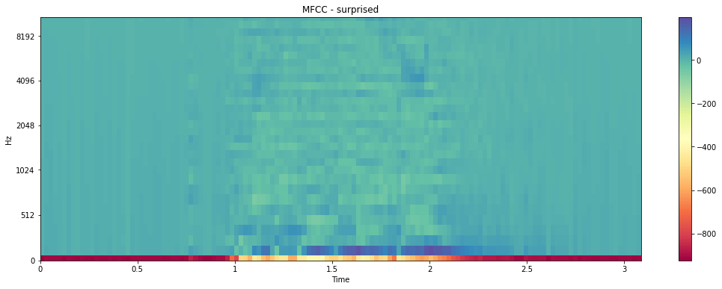
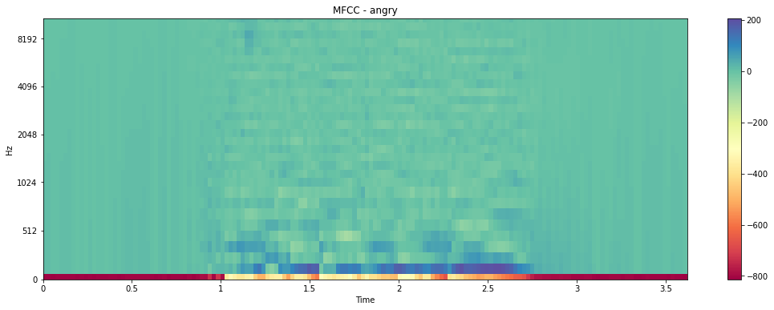
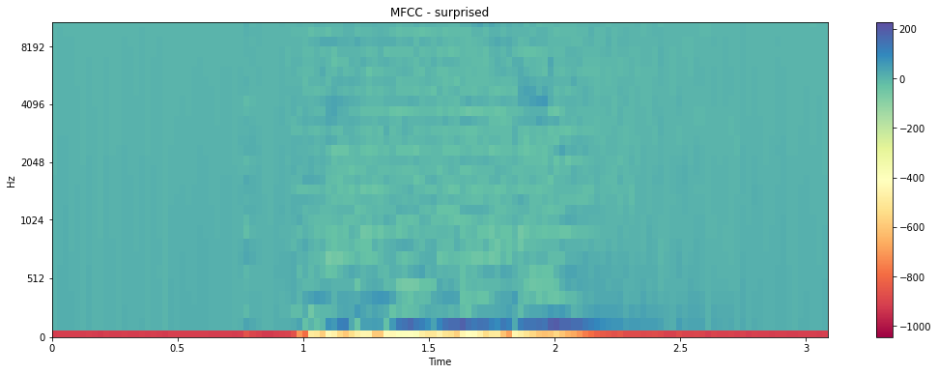
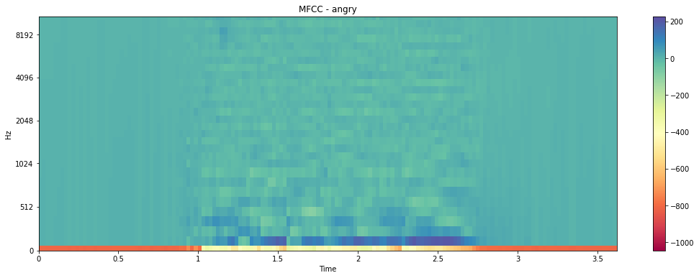
Data Exploration and Visualizations
Original Scale
Normalized Scale
Emotions like calm and sad, which are having low amplitudes shows much more dark blue regions. These emotions are difficult to differentiate.
Emotions like angry and disgust, which are having large amplitudes shows much more light blue regions in MFCC spectral plot. These emotions are also difficult to differentiate.
Emotions like surprised and happy are impulsive and occurs for a shorter duration.
Notes:
MFCC features represent better distinctions in between various emotions in terms of loudness, the spread of emotions, and frequency ranges. This is the reason why MFCC features are best suited for acoustic modeling and are used widely in the research work.

Slide 6
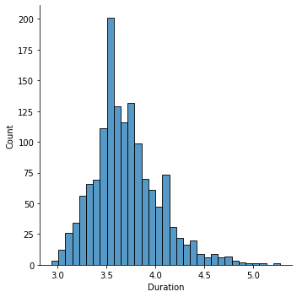
Preprocessing Steps
Map the labels for each .wav file as following
neutral : 0
calm : 1
happy : 2
sad : 3
angry : 4
fearful : 5
disgust : 6
surprised : 7
Maximum duration of 4.5 seconds is considered for calculating audio features e.g. MFCC, contrast etc.
Based on duration of 4.5 seconds, dimension of features along time axis is 194
Zero padding is done for features having less than 194 dimensions along time axis
Duration of audio files:
Count 1440
Mean 3.70 seconds
Std 0.34 seconds
Min 2.94 seconds
Max 5.27 seconds

Slide 7
Exploration of various Models
Experiment# 1
Experiment# 2
Experiment# 3
Experiment# 4
Base CNN Network
Val Accuracy: 0.35
CNN Networks
CNN Transformer Network V1
Val Accuracy: 0.14
CNN Networks
Variant 1
Val Accuracy: 0.36
CNN Attention Network
Val Accuracy: 0.31
Variant 2
Val Accuracy: 0.58
Variant 3
Val Accuracy: 0.32
Variant 4
Val Accuracy: 0.64
Variant 5
Val Accuracy: 0.57
Variant 6
Val Accuracy: 0.62
Variant 7
Val Accuracy: 0.60
Variant 8
Val Accuracy: 0.59
CNN Con1D Networks
Variant 1
Val Accuracy: 0.66
Variant 2
Val Accuracy: 0.55
CNN Transformer Network V2
Val Accuracy: 0.66
Time Distributed CNN + LSTM Network
DOE done
Minimum Val Accuracy: 0.20
Maximum Val Accuracy: 0.97
Experiment# 5
Experiment# 8
Experiment# 7
Experiment# 6

Slide 8
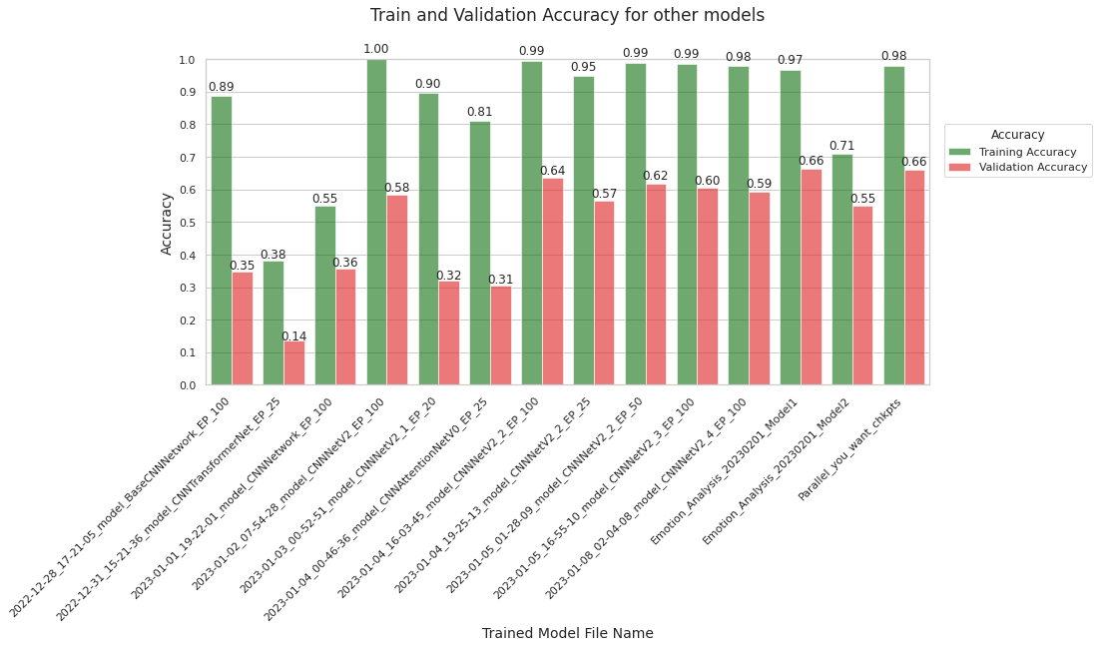
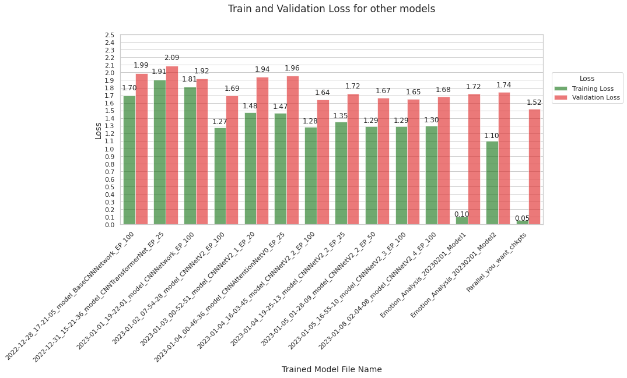
Exploration of various Models and their Performances Metrics
Implementation of model from reference paper got only 35% validation accuracy after 100 epochs against 71.61% claimed in paper after 700 epochs
Various other networks e.g. CNNs including Conv1D and Conv2D, CNN Transformer, CNN Attention etc.
Out of 14 different models, maximum validation accuracy of 66% achieved with two models using 1) Conv1D and, 2)Conv2D and Transformer Encoder
Notes:
We tried 14 different models

Slide 9
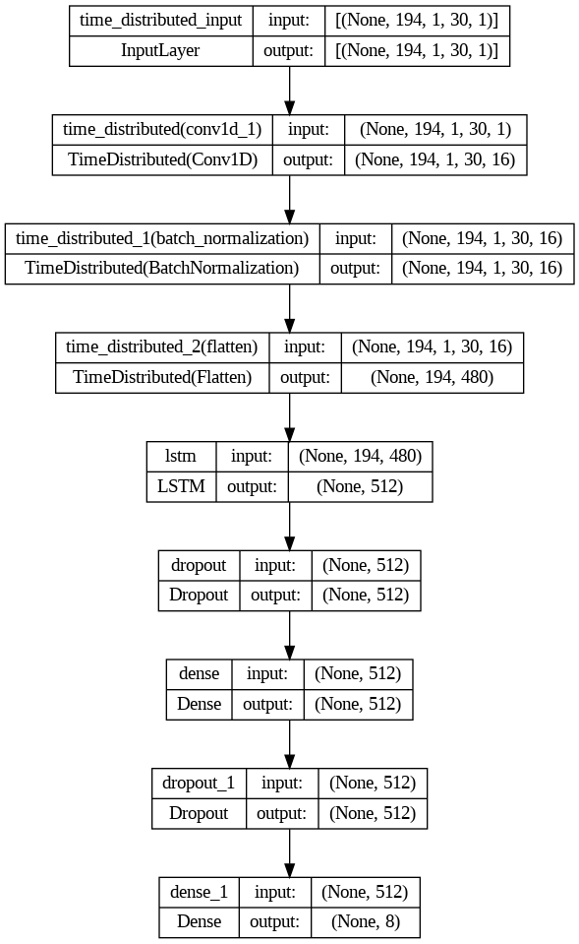
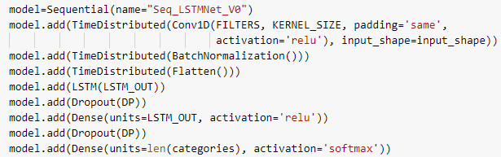
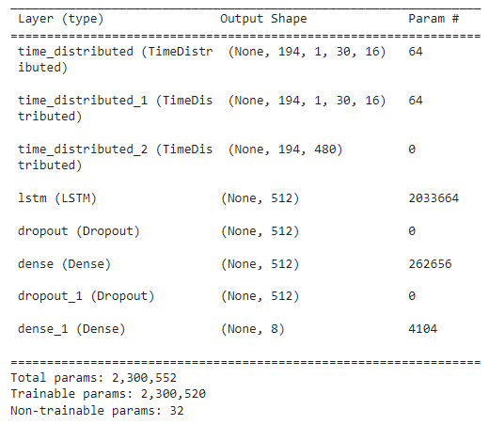
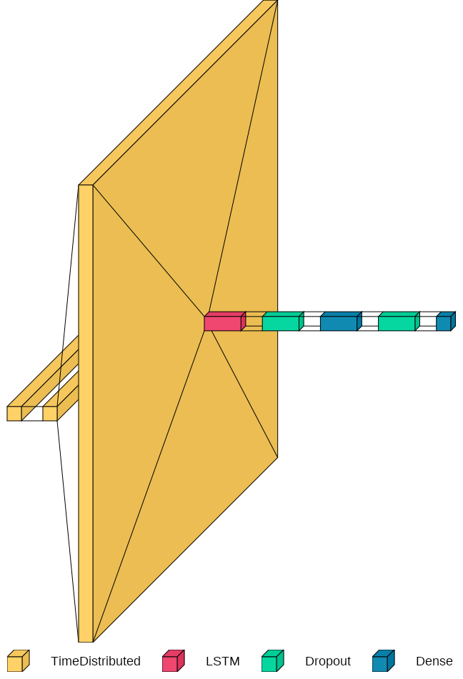
Final Parametric Model
Final Parametric Model
Model Summary
Parametric model of 8 layers was built using Keras Sequential function
TimeDistributed function is used to apply same instance of Conv1D, BatchNormalization and Flatten functions to each of the 194 timesteps. The same set of weights are used at each timestamp.
Notes:
Learning rate was reduced by factor of 0.5, in case of no improvement is seen in validation loss for 4 epochs

Slide 10
Constant Parameters
Hyperparameter | Value | Remark
Dataset | Ravdess | Speech samples are considered
SampleRate | 22050 | Sampling rate
AudioDuration | 4.5 | Maximum duration of audio file
offset | 0.0 | Offset or start of audio file
HopLength | 512 | Hop Length
WinLength | 512 | Length of Window
Window | hann | Window function
n_fft | 2048 | Length of the FFT window
n_chroma | 12 | Number of chroma bins
n_bands | 6 | Number of frequency bands
fmax | 1024 | Highest frequency (in Hz)
Hyperparameter | Value | Remark
MaxInputLength | 194
n_folds | 5 | Number of folds
TestSize | 0.2 | Test dataset split size
BatchSize | 128 | Batch size
NumEpochs | 100 | Number of Epoch
InitialLearningRate | 0.001 | Initial learning rate
Dropout | 0.2
LossFunction | categorical_crossentropy
Optimizer | Adam
n_classes | 8 | Number of categories
Above mentioned parameters are kept constant during all the experiments

Slide 11
Tuned Hyper-parameters
Feature Related
Model Related
Augmentations
Above mentioned parameters are varied one at a time during the experiments
Total of 250# DOE performed to select best hyperparameters

Slide 12
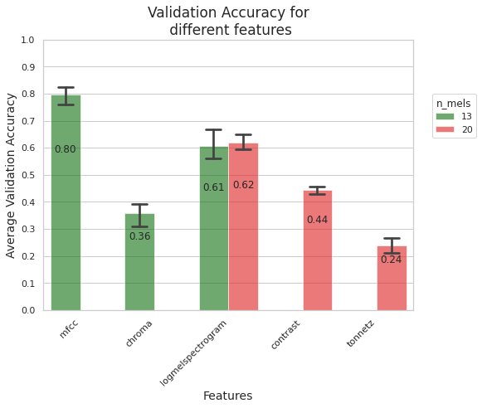
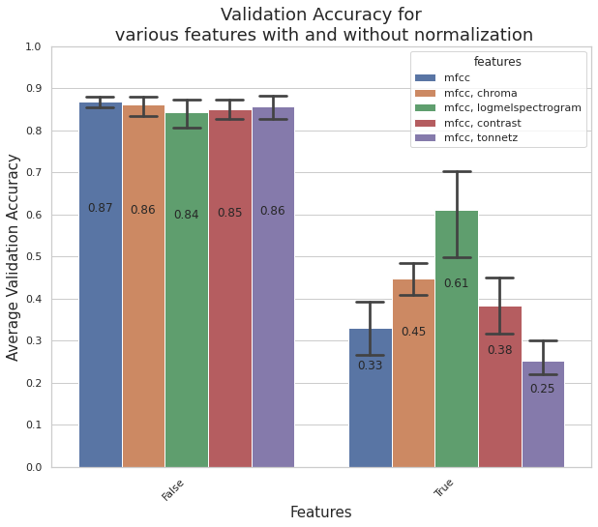
Validation Accuracy for different Features
n_mfcc | 20
n_mels | 13
lstm_out | 512
n_filters | 16
kernel_size | 3
AudioAugmentation | TRUE
SpecAugmentation | FALSE
AudioAugmentMethod | noise, pitch, None
n_mfcc | 20
normalization | FALSE
lstm_out | 128
n_filters | 16
kernel_size | 3
AudioAugmentation | TRUE
SpecAugmentation | FALSE
AudioAugmentMethod | noise, pitch, None
MFCC features having highest discrimination power are giving maximum average validation accuracy in comparison with chroma, log-mel spectrogram, contrast and tonnetz acoustic features
There is no improvement in average validation accuracy if we combine different features with MFCC features. After normalization of features average validation accuracy is reducing drastically.

Slide 13
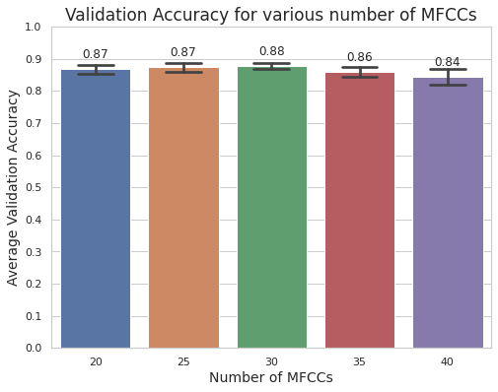
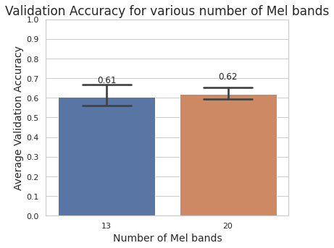
Validation Accuracy for different MFCCs and Number of Mel Bands
features | mfcc
normalization | FALSE
lstm_out | 512
n_filters | 16
kernel_size | 3
AudioAugmentation | TRUE
SpecAugmentation | FALSE
AudioAugmentMethod | noise, pitch, None
features | Log-mel spectrogram
normalization | FALSE
lstm_out | 128
n_filters | 16
kernel_size | 3
AudioAugmentation | TRUE
SpecAugmentation | FALSE
AudioAugmentMethod | noise, pitch, None
Maximum average validation accuracy is observed for 30 MFCCs in case of MFCC features
Maximum average validation accuracy is observed for 20 # of Mel bands in case of log-mel spectrogram features

Slide 14
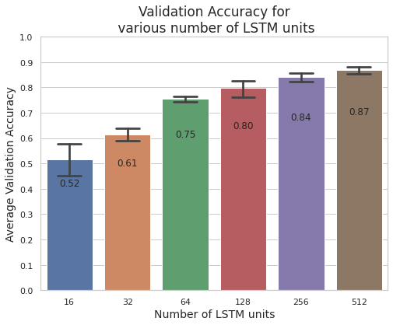
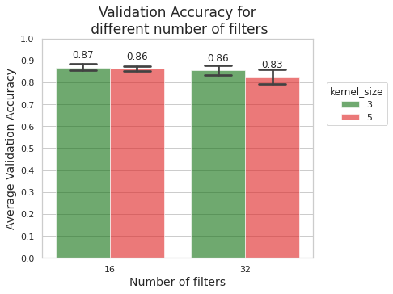
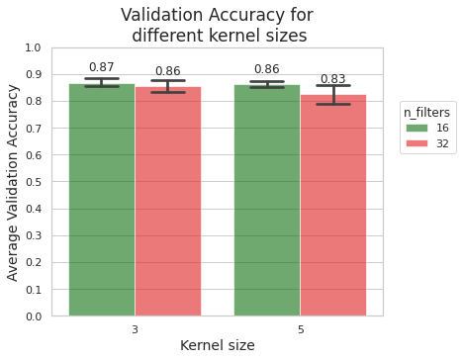
Validation Accuracy for LSTM units, number of Filters and Kernel Size
features | mfcc
n_mfcc | 20
normalization | FALSE
n_filters | 16
kernel_size | 3
AudioAugmentation | TRUE
SpecAugmentation | FALSE
AudioAugmentMethod | noise, pitch, None
features | mfcc
n_mfcc | 20
lstm_out | 512
normalization | FALSE
AudioAugmentation | TRUE
SpecAugmentation | FALSE
AudioAugmentMethod | noise, pitch, None
Increasing the number of LSTM units, increases the average validation accuracy. Maximum average validation accuracy is observed for 512 LSTM units
Maximum average validation accuracy is observed for 16# of Filters and Kernel Size of 3

Slide 15
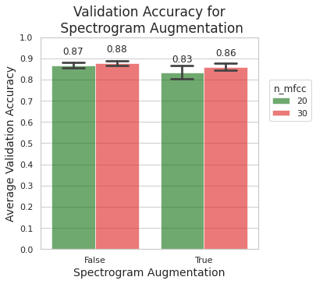
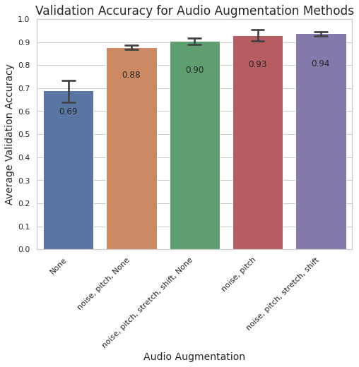
Validation Accuracy for different Augmentations
features | mfcc
n_mfcc | 30
lstm_out | 512
n_filters | 16
kernel_size | 3
normalization | FALSE
SpecAugmentation | FALSE
Number of samples
features | mfcc
lstm_out | 512
n_filters | 16
kernel_size | 3
normalization | FALSE
AudioAugmentation | TRUE
AudioAugmentMethod | noise, pitch, None
 | Train dataset |  |  | Validation dataset
 | Original audio files | Augmented audio files | Total | Original audio files | Augmented audio files | Total
None | 1152 | 0 | 1152 | 288 | 0 | 288
noise, pitch, None | 1152 | 963 | 2115 | 288 | 0 | 288
noise, pitch, stretch, shift, None | 1152 | 1169 | 2321 | 288 | 0 | 288
noise, pitch | 1152 | 1440 | 2592 | 288 | 0 | 288
noise, pitch, stretch, shift | 1152 | 1440 | 2592 | 288 | 0 | 288
Spectrogram augmentation doesn’t improve the average validation accuracy
Average validation accuracy is significantly improved by using augmented audio files in train dataset
Maximum average validation accuracy is obtained by using all four types of audio data augmentations

Slide 16
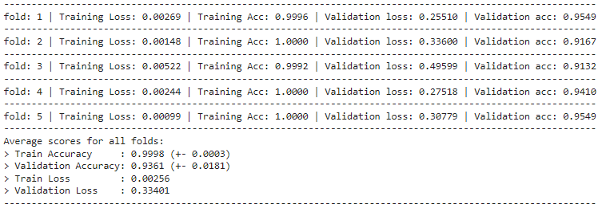
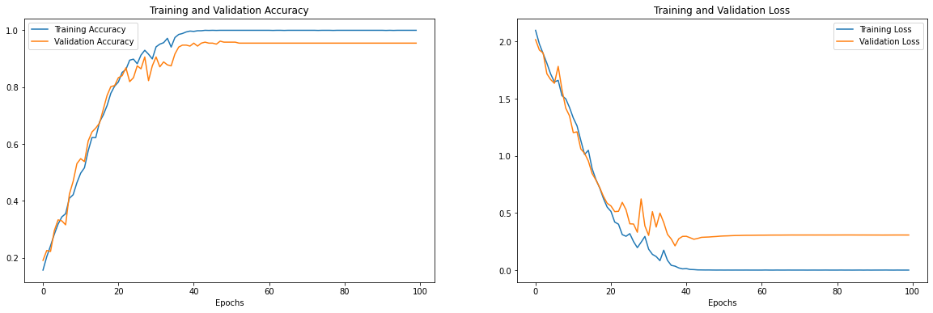
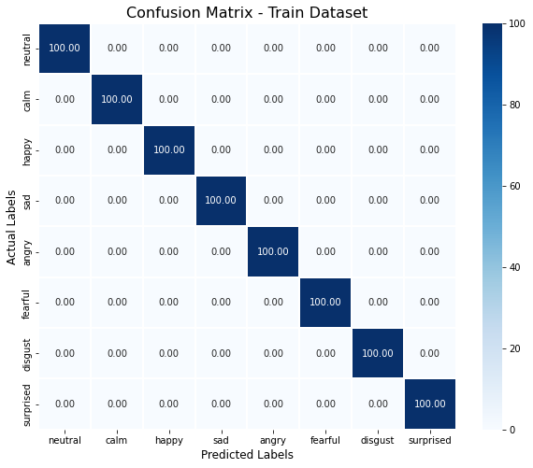
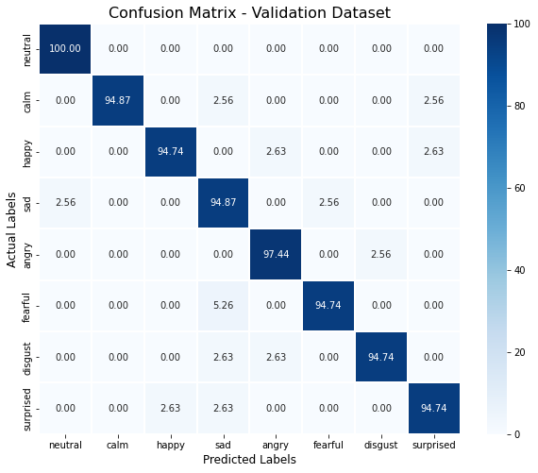
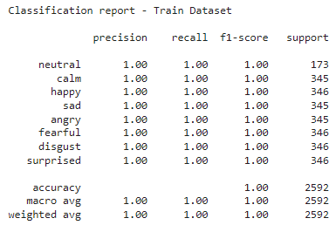
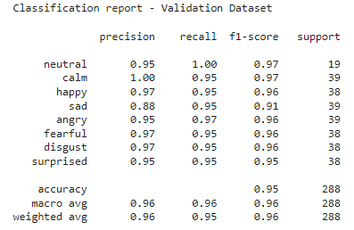
Tuned Model Performance Metrics
Scores per Fold
Accuracy and Loss of last Fold
Predictions using model from last fold on train and validation dataset of last fold
Notes:
ReduceLROnPlateau reducing learning rate

Slide 17
Conclusions
Tuned final model achieved state of the art 93.61% average validation accuracy in five fold cross validation
Maximum average validation accuracy is observed using
MFCCs: 30
LSTM units: 512
Number of Filters: 16
Kernel Size: 3
Audio data augmentations: all four types (noise, pitch, stretch, shift) in train dataset
TimeDistributed function over 194 timesteps
Time required to finish one run is about 15 mins on an average for final model, whereas other models used to take about 7 hours for one run. This is huge improvement in training time.
Future work: We can add additional data like songs, facial expressions which could improve the Average validation accuracy.

Slide 18
BACK-UP

Slide 19
References
Speech emotion recognition with deep convolutional neural networks
Dias Issa, M. Fatih Demirci, Adnan Yazici
Department of Computer Science, Nazarbayev University, Nur-Sultan 010000, Kazakhstana
.. (Need to add more references)

